Slide 1
Simple Computer Codes for Evaluating Absorbed Doses in Materials Irradiated by Electron Beams
The 62nd ONSA Database Committee,
October 7, 1996, Osaka
T. Tabata
RIAST, Osaka Pref. Univ.

Slide 2
Contents
Modeling of Real Configuration
Semiempirical Models for Depth–Dose Curves of Electrons*
Introduction, etc.
A Brief History and Principle of the Semiempirical Models (EDEPOS and EDMULT codes)
Applications of EDMULT
Future of Semiempirical Models
Conclusion
*Mostly from the talk given at the Int. Workshop
on Electron and Photon Transport Theory
Applied to Radiation Dose Calculation, Sept.
18–22, 1995, Seattle, WA, U. S. A.

Slide 3
Modeling of Real Configuration
Real Configuration for Electron Beam Irradiation and a Simplified Model
Real configuration
Multilayer model

Slide 4
Evaluation of Absorbed Dose D

Slide 5
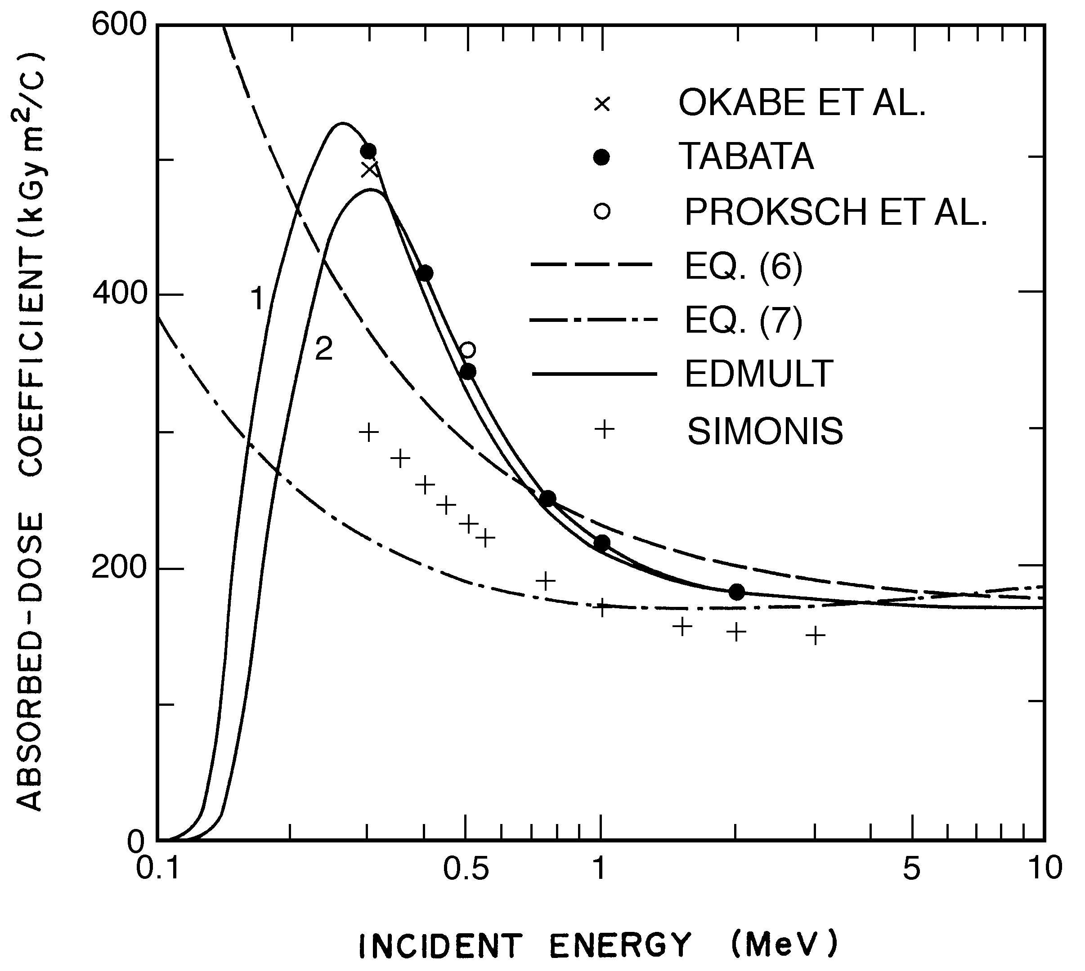
Examples of Absorbed Dose Coefficient K
SIMONS: Simonis, P. J. in “The handbook of Electron Beam Processing” (High Voltage Engineering, Vol. IND-001, 1975)

Slide 6
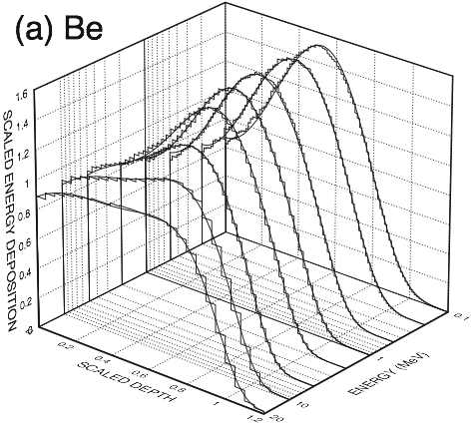
Comparison of EDEPOS (’96 Version) with ITS Monte Carlo Data

Slide 7
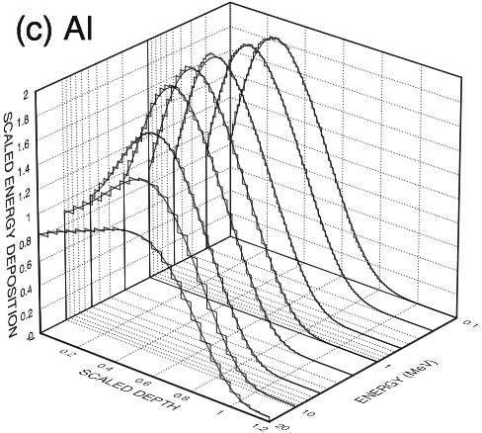
Comparison of EDEPOS with ITS Monte Carlo Data (Cont.)

Slide 8
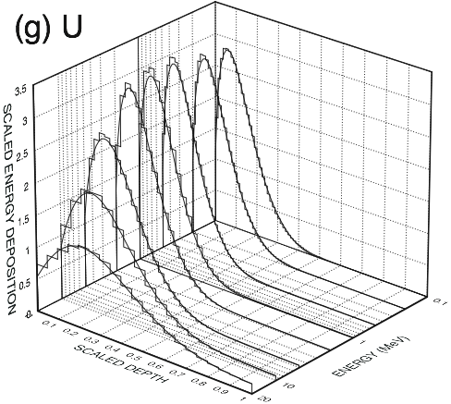
Comparison of EDEPOS with ITS Monte Carlo Data (Cont.)

Slide 9
Applications of EDMULT
Effect of Backing Material
Effect of the Thickness of the Air Layer

Slide 10
Applications of EDMULT (Cont.)
Effect of Backscattering for Different Sample Thicknesses

Slide 11
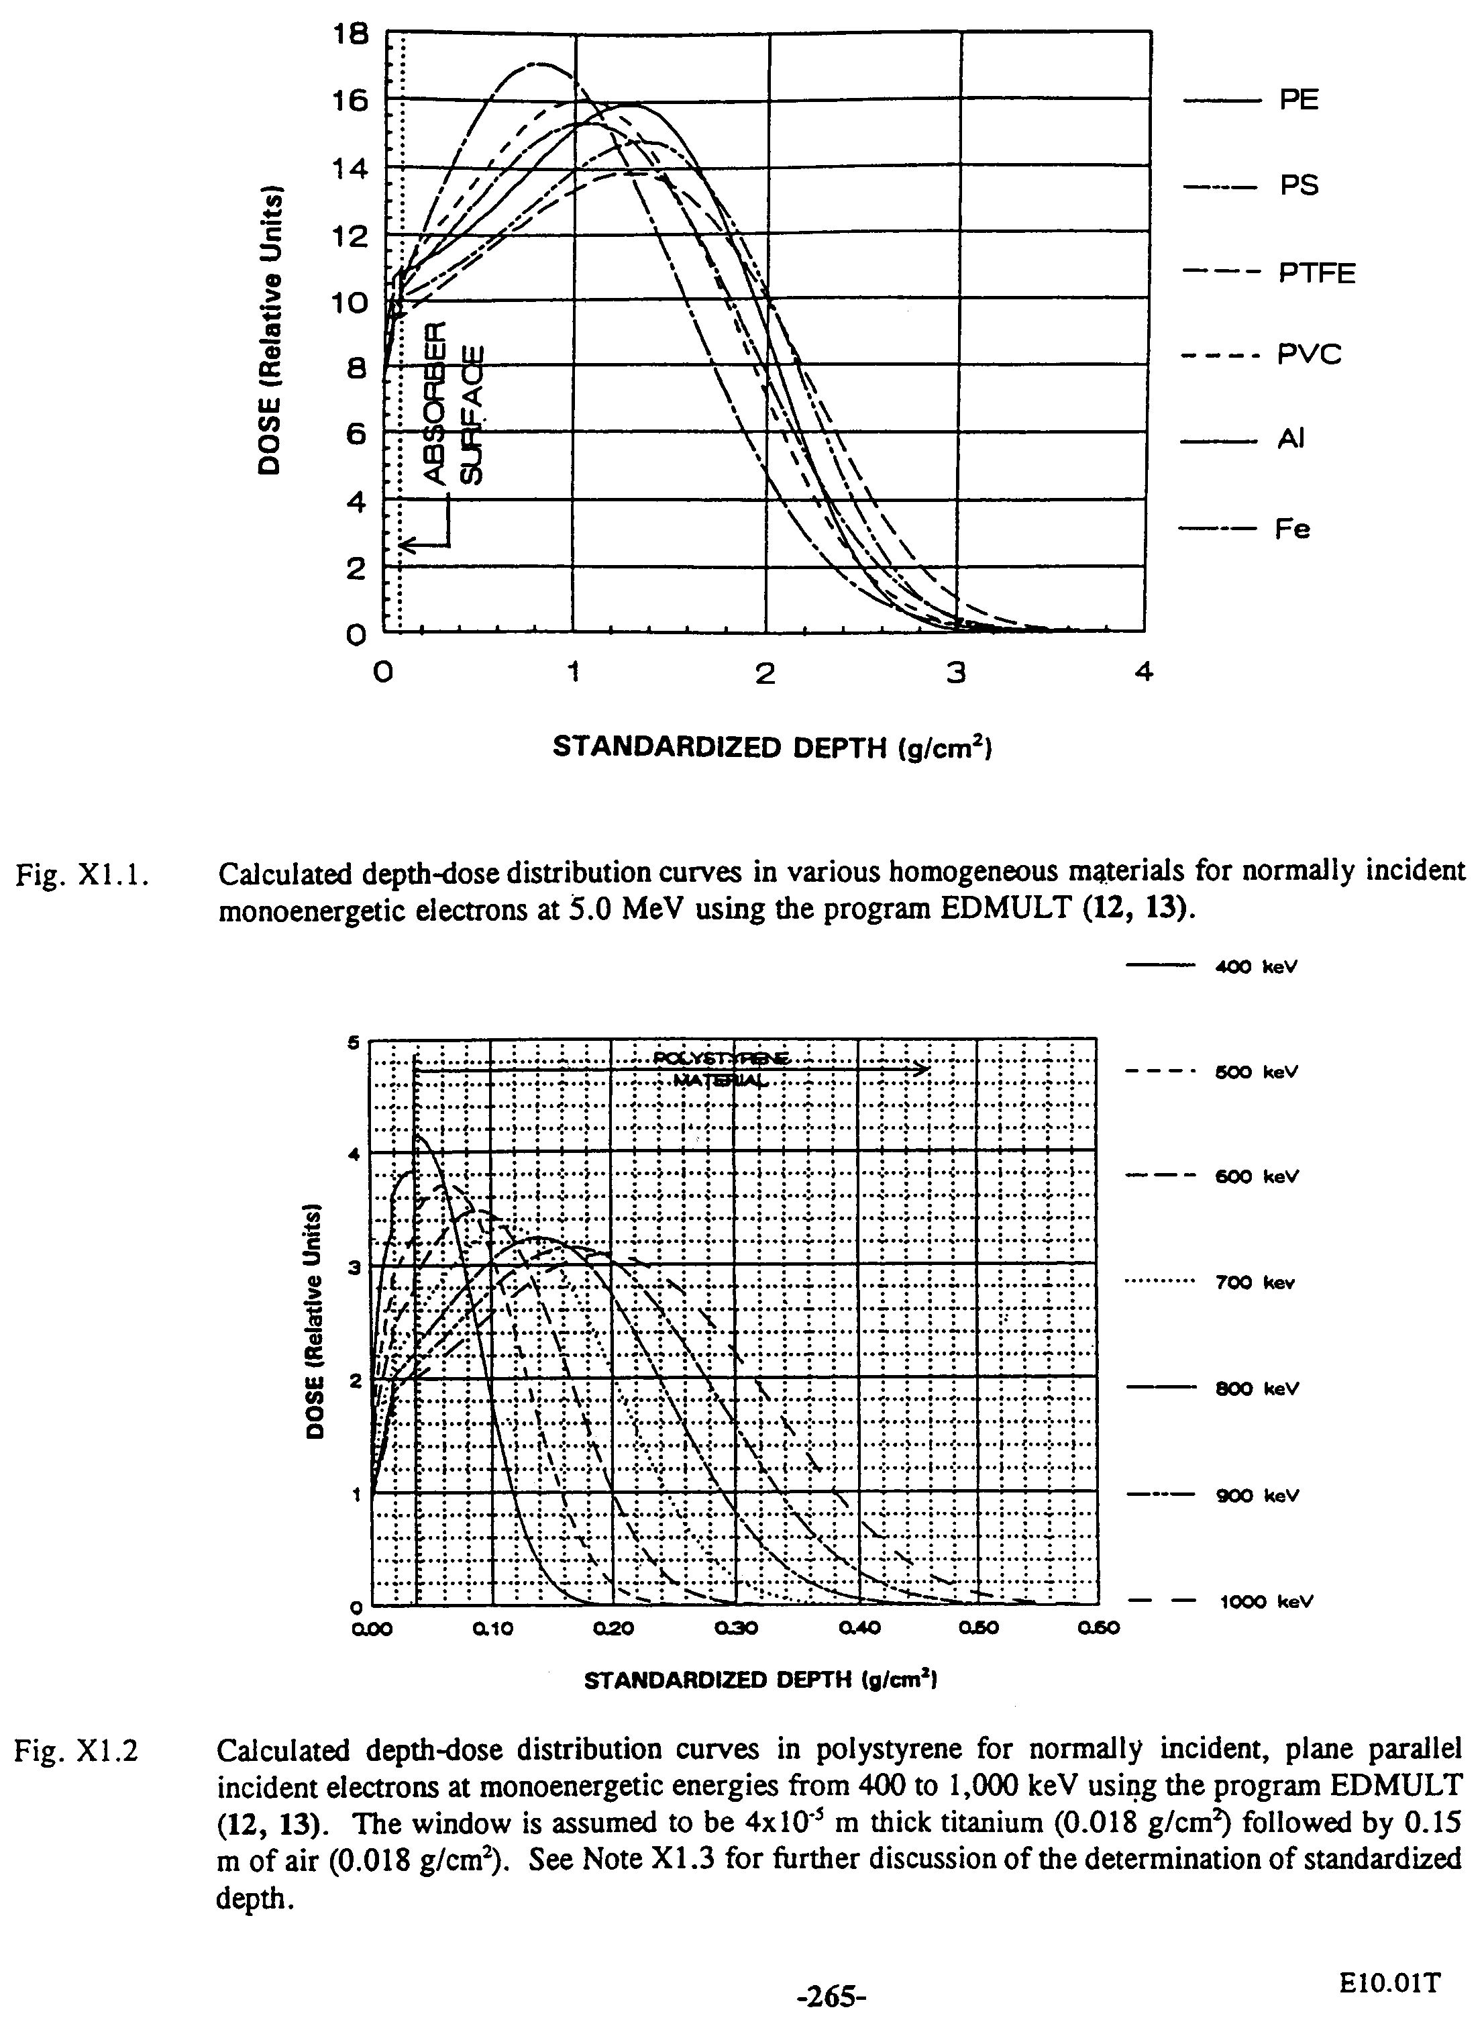
Applications of EDMULT (Cont.)
Quick Evaluation of Depth–Dose Curves for Many Conditions
ASTM (American Society for Testing and Materials) Document E10.01

Slide 12
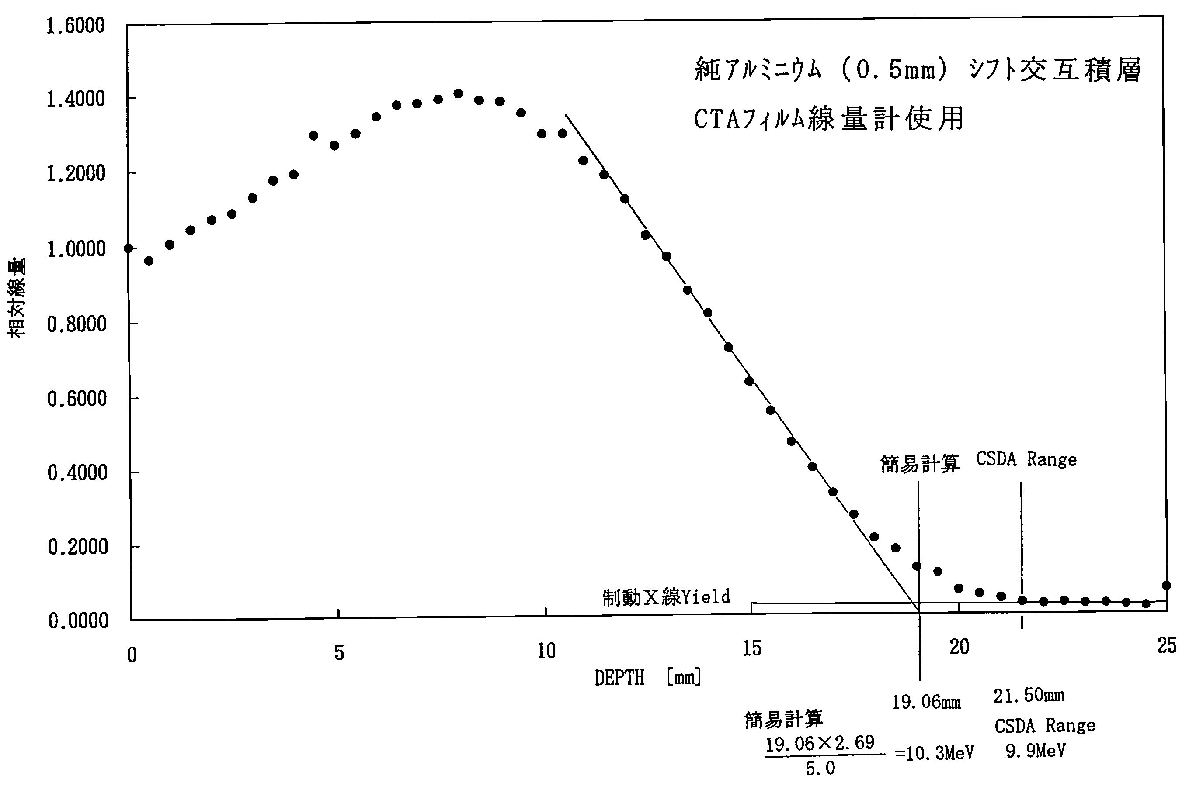
Applications of EDMULT (Cont.)
Energy Calibration of Accelerators

Slide 13
Improved empirical relations
Extrapolated-range formula used in η_{TN}(z) and T(z) (in press)
Old equation
New equation

Slide 14
Improved empirical relations (Cont.)
Inspite of many improvements, however, we use tables of data and an interpolation method for limited numbers of absorbers to get higher precision.
Tables provided are:
CSDA range
Extrapolated range
Energy-backscattering coefficient
Absorbers for which tables and interpolation are used are:
Be, C, Al, Cu, Ag, Au, U
A150, air, C552, PMMA, water, WT1

Slide 15
Improved EDEPOS code
’95 version
Solid line, new EDEPOS (’95 Ver.)
Dashed line, old EDEPOS (’90 Ver.)
Histogram, ITS
Points, experiment from literature

Slide 16
Improved EDEPOS code (cont.)
Comparison of the weighted relative rms
Deviations δ averaged over energies from
0.1 to 20 MeV

